Slide 1
Trees
Johnny
Notes:
Not talk about textbook knowledge. Share my ideas and thought about interview.
People can understand answers by looking others code. However, it’s hard to see patterns from questions to solutions.
Topic today will be trees.

Slide 2
Agenda
Basic knowledge of Trees
Tree Traversal
BST
Balance of Trees
Variants of Trees

Slide 3
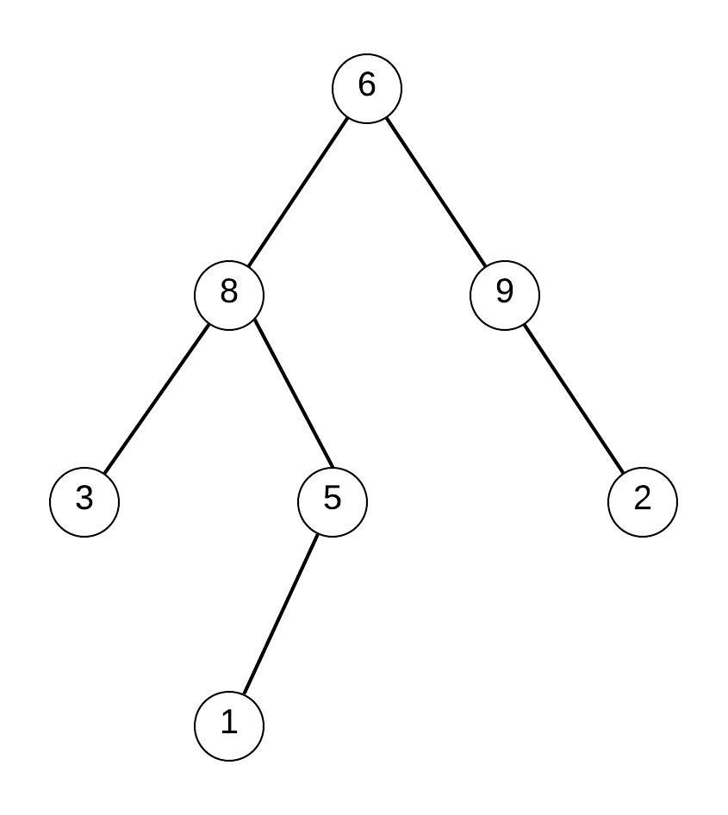
Definition of Binary Tree
Binary tree is a tree data structure in which each node has at most two children, which are referred to as the left child and the right child.
Notes:
No cycle
Directed
Left or right child could be null

Slide 4
Implementation in C++
struct TreeNode {
TreeNode *left;
TreeNode * right;
int val;
TreeNode(int val_) : val{val_}, left{nullptr}, right{nullptr} {}
};
Notes:
Constructor need a value for node
Left root and right root by default will be nullptr
Good enough for most questions
Some question may add more private variables.

Slide 5
Trees vs List
Root is the only entry point
Recursive call is most intuitive solution
Stack with node is by default
Information can be passed from Parent to child or child to parent
Signature is very important
Notes:
Stack size on most operating system is either 8M or 64M.

Slide 6
Overview
Basic knowledge of Trees
Tree Traversal
BST
Balance of Trees
Variants of Trees

Slide 7
DFS Traversal
In-order: 3 8 1 5 6 9 2
Pre-order: 6 8 3 5 1 9 2
Pre-order: 3 1 5 8 2 9 6

Slide 8
DFS Traversal in C++
void DFS(TreeNode *root) {
if (!root)
return;
// cout << root->val << " ";
DFS(root->left);
cout << root->val << " ";
DFS(root->right);
// cout << root->val << " ";
}
Pre-order
In-order
Post-order
Notes:
All traversal functions take left before right
Only where to put root matters.

Slide 9
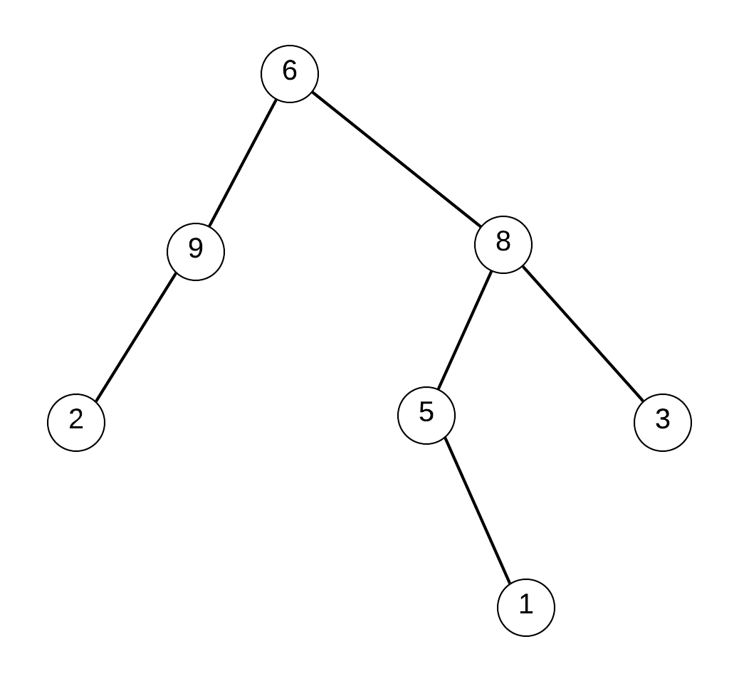
Let’s invert a tree
Notes:
Google interview question to the author of Homebrew
Identify this is a traversal question
Put skeleton first
Pre post inorder

Slide 10
void invertTree(TreeNode *root) {
if (!root)
return;
invertTree(root->left);
invertTree(root->right);
}

Slide 11
void invertTree(TreeNode *root) {
if (!root)
return;
swap(root->left, root->right);
invertTree(root->left);
invertTree(root->right);
}
Notes:
Always use built-in function such as sway first. Clean code is better code.

Slide 12
Height of a Tree
4
2
3
1
2
1
1
Notes:
Joke about root should be lowest, this is a tree in space
Need to get information from child
Return is good enough
Some complicated can return struct

Slide 13
int getHeight(TreeNode *root) {
if (!root)
return 0;
int leftHeight = getHeight(root->left);
int rightHeight = getHeight(root->right);
return ?;
}

Slide 14
int getHeight(TreeNode *root) {
if (!root)
return 0;
int leftHeight = getHeight(root->left);
int rightHeight = getHeight(root->right);
return max(leftHeight, rightHeight) + 1;
}

Slide 15
Find path sum in Tree
Find sum 17
Notes:
always double check for definition
Deduce from the result
Draw final result to help

Slide 16
bool findPath(TreeNode *root, int sum_so_far, int sum) {
if (nullptr == root) return false;
int current_sum = root->val + sum_so_far;
if (findPath(root->left, current_sum, sum)) return true;
if (findPath(root->right, current_sum, sum)) return true;
return false;
}
Notes:
Return bool and if statement are related to each other.

Slide 17
bool findPath(TreeNode *root, int sum_so_far, int sum) {
if (nullptr == root) return false;
int current_sum = root->val + sum_so_far;
if (current_sum == sum && root->left == nullptr && root->right == nullptr) return true;
if (findPath(root->left, current_sum, sum)) return true;
if (findPath(root->right, current_sum, sum)) return true;
return false;
}

Slide 18
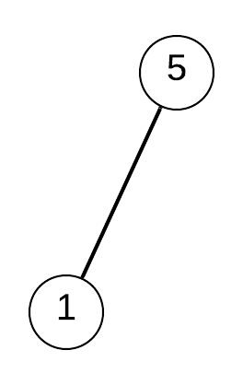
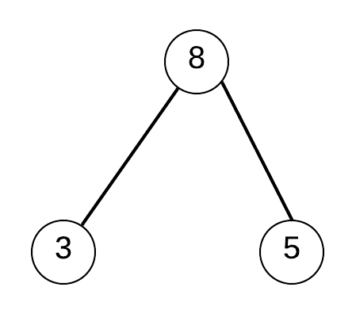
Is a Subtree?
Yes
No
Notes:
Very good interview question, easy to find a solution, need analysis for better solution. Best one even can have more innovation solution or become difficult with extra constraint.

Slide 19
bool isSubtree(TreeNode * t1, TreeNode * t2) {
if (!t2)
return true;
if (!t1)
return false;
if (isSubtree(t1->left, t2)) return true;
if (isSubtree(t1->right, t2)) return true;
return false;
}

Slide 20
bool isSubtree(TreeNode * t1, TreeNode * t2) {
if (!t2)
return true;
if (!t1)
return false;
if (isEqual(t1, t2)) return true;
if (isSubtree(t1->left, t2)) return true;
if (isSubtree(t1->right, t2)) return true;
return false;
}
Notes:
Highly recommend to use helper function. Pro: make code easy to read. Make big problem smaller.

Slide 21
bool isEqual(TreeNode *t1, TreeNode *t2) {
if (!t1)
return t2 == nullptr;
if (!t2)
return t1 == nullptr;
if (!isEqual(t1->left, t2->left)) return false;
if (!isEqual(t1->right, t2->right)) return false;
return true;
}

Slide 22
bool isEqual(TreeNode *t1, TreeNode *t2) {
if (!t1)
return t2 == nullptr;
if (!t2)
return t1 == nullptr;
if (t1->val != t2->val) return false;
if (!isEqual(t1->left, t2->left)) return false;
if (!isEqual(t1->right, t2->right)) return false;
return true;
}
Notes:
Don’t overthink t2 part, leave there make us don’t think! Interview, time is valuable.

Slide 23
BFS Traversal
[
[ 6 ]
[8, 9]
[3, 5, 2]
[1]
]
Notes:
Never saw a good problem about BFS Traversal for Trees
BFS traversal is common in Graph

Slide 24
void BFS(TreeNode *root) {
if (!root) return;
queue<TreeNode *> nodes;
nodes.push(root);
while (!nodes.empty()) {
int count = nodes.size();
for (int i = 0; i < count; ++i) {
auto node = nodes.front();
nodes.pop();
cout << node->val << " ";
if (node->left) nodes.push(node->left);
if (node->right) nodes.push(node->left);
}
cout << endl;
}
}

Slide 25
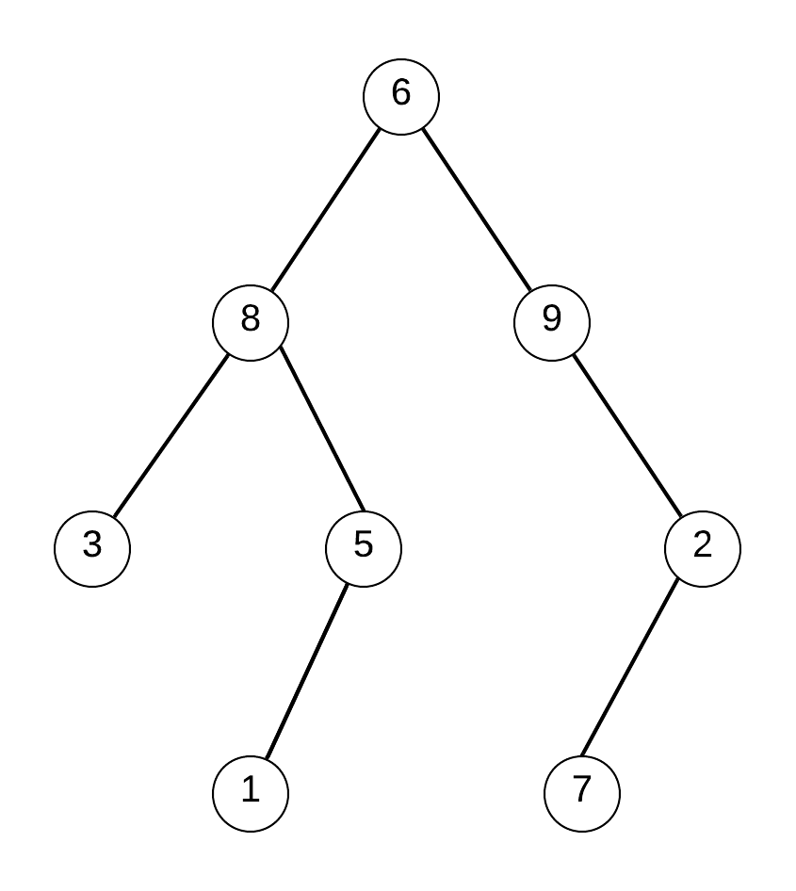
Zig zag
[
[ 6 ]
[9, 8]
[3, 5, 2]
[7, 1]
]

Slide 26
vector<vector<int>> zigZag(TreeNode *root) {
vector<vector<int>> r;
if (!root) return r;
queue<TreeNode *> nodes;
bool isZig = true;
nodes.push(root);
while (!nodes.empty()) {
int count = nodes.size();
vector<TreeNode *> currentLevel(nodeCount);
for (int i = 0; i < count; ++i) {
auto node = nodes.front();
nodes.pop();
currentLevel[i] = node;
if (node->left) nodes.push(node->left);
if (node->right) nodes.push(node->right);
}
if (!isZig)
reverse(currentLevel.begin(),
currentLevel.end());
r.push_back(currentLevel);
isZig = !isZig;
}
return r;
}

Slide 27


Slide 28
Overview
Basic knowledge of Trees
Tree Traversal
BST
Balance of Trees
Variants of Trees

Slide 29
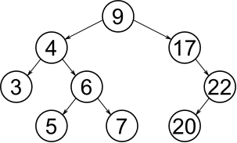
Definition Of BST
A binary search tree is binary tree.
Each child must either be a leaf node or the root of another binary search tree. The left sub-tree contains only nodes with keys less than the parent node; the right sub-tree contains only nodes with keys greater than the parent node.

Slide 30
BST over Hash Table
Ordered
Searching for closest lower or greater elements
Range queries
Low Level Storage for Set
Notes:
Always hash table first!
Hash Table supports following operations in Θ(1) time.
1) Search
2) Insert
3) Delete

Slide 31
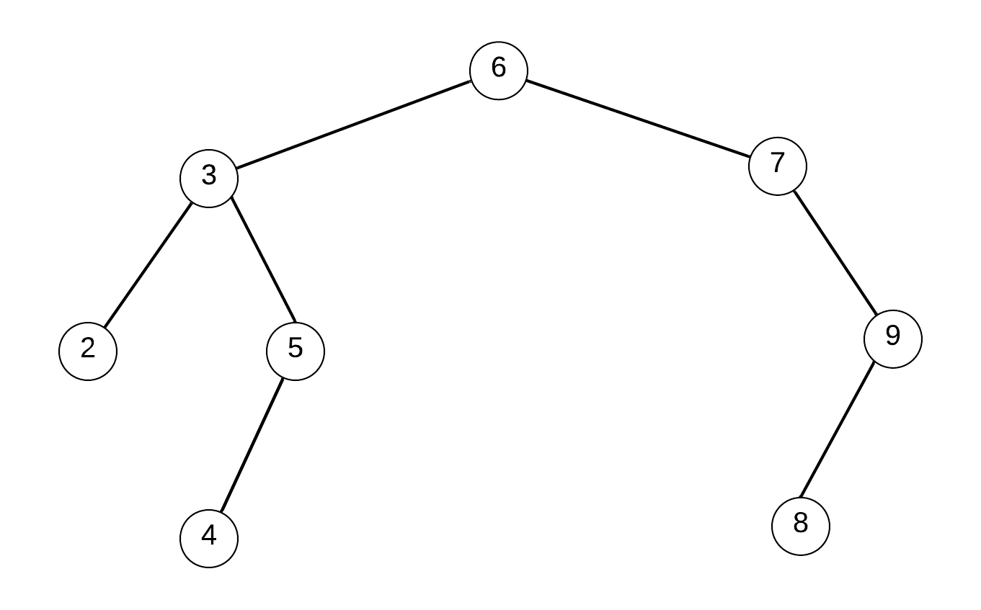

Is BST?
Yes
No
Notes:
Each child must either be a leaf node or the root of another binary search tree. This condition can be checked by return value.
The left sub-tree contains only nodes with keys less than the parent node; the right sub-tree contains only nodes with keys greater than the parent node. This condition need pass down something.

Slide 32
bool isValidBST(TreeNode *root, int maxParent, int minParent) {
if (root == nullptr) return true;
if (!isValidBST(root->left, root->val, minParent)) return false;
if (!isValidBST(root->right, maxParent, root->val)) return false;
return true;
}

Slide 33
bool isValidBST(TreeNode *root, int maxParent, int minParent) {
if (root == nullptr) return true;
if (root->val <= minParent || root->val >= maxParent) return false;
if (!isValidBST(root->left, root->val, minParent)) return false;
if (!isValidBST(root->right, maxParent, root->val)) return false;
return true;
}

Slide 34
isValidBST(root, INT_MAX, INT_MIN);
bool isValidBST(TreeNode *root, int maxParent, int minParent) {
if (root == nullptr) return true;
if (root->val == INT_MAX) { if (root->right) return false;}
else if (root->val == INT_MIN) {if (root->left) return false;}
else if (root->val <= minParent || root->val >= maxParent) return false;
if (!isValidBST(root->left, root->val, minParent)) return false;
if (!isValidBST(root->right, maxParent, root->val)) return false;
return true;
}
Notes:
C++ trouble. What if the node value is edge case.

Slide 35

Jackpot
DO NOT JUMP TO CODE!!!
Create more examples to confirm the question
Explain your thought loud and clear
Code only when interviewee agreed
Put thought in comment alongside the code
Notes:
How to react when you know the solutions! Control rhythm. Step by step.
Hire Decision: Strong No, No, Yes, Strong Yes
Strong Yes is the king!!! Level, compensation, contra no.

Slide 36
Count of BST in a Tree
8
6

Slide 37
int countBST(TreeNode *root) {
if (root == nullptr) return 0;
int leftCount = countBST(root->left);
int rightCount = countBST(root->right);
int childCount = leftCount + rightCount;
return isValidBST(root) ? childCount + 1 : childCount;
}

Slide 38
Each child must either be a leaf node or the root of another binary search tree.
The left sub-tree contains only nodes with keys less than the parent node; the right sub-tree contains only nodes with keys greater than the parent node.
8
6

Slide 39
BSTInfo NumberOfBST(TreeNode* root)
{
if (root == NULL)
return { 0, INT_MIN, INT_MAX, true };
BSTInfo L = NumberOfBST(root->left);
BSTInfo R = NumberOfBST(root->right);
return ?;
}
struct BSTInfo {
int num_BST;
int max;
int min;
bool isBST;
};

Slide 40
BSTInfo NumberOfBST(TreeNode* root)
{
// ....
BSTInfo info;
info.min = min(root->data, (min(L.min, R.min)));
info.max = max(root->data, (max(L.max, R.max)));
if (L.isBST && R.isBST && root->data > L.max && root->data < R.min) {
info.isBST = true; info.numBST = 1 + L.numBST + R.numBST;
} else {
info.isBST = false; info.numBST = L.numBST + R.numBST;
}
return info;
}
struct BSTInfo {
int num_BST;
int max;
int min;
bool isBST;
};

Slide 41
2-sum in BST
14 => True
42 => False

Slide 42
bool findTarget(TreeNode *root, TreeNode *topRoot, int k) {
if (!root) return false;
if (findTarget(root->left, topRoot, k)) return true;
if (findTarget(root->right, topRoot, k)) return true;
return false;
}

Slide 43
bool findTarget(TreeNode *root, TreeNode *topRoot, int k) {
if (!root) return false;
int target = k - root->val;
if (target != root->val && hasVal(topRoot, target)) return true;
if (findTarget(root->left, topRoot, k)) return true;
if (findTarget(root->right, topRoot, k)) return true;
return false;
}
Notes:
Doesn’t matter pre order, post order or in order. Preorder can save time with no cost.

Slide 44
bool hasVal(TreeNode *root, int val) {
if (!root) return false;
if (root->val == val) return true;
if (val < root->val)
return hasVal(root->left, val);
return hasVal(root->right, val);
}
Notes:
Normal search operation, no need for traversal. Time complexity is O(h) height of binary tree. For balanced Tree, it will be O(lg(n))

Slide 45
Binary Search Tree Iterator
class BSTIterator {
public:
BSTIterator(TreeNode* root) {}
/** the next smallest number */
int next() {}
/** whether we have a next smallest number */
bool hasNext() {}
};
BSTIterator iterator = new BSTIterator(root);
iterator.next(); … iterator.next();
2 3 4 5 6 7 8 9

Slide 46
5
class BSTIterator {
private:
// TreeNode *current
stack<TreeNode *> s;
public:
BSTIterator(TreeNode* root) {}
};
2
6
1
4
8
7
3
2 3 4 5 6 7 8 9
Notes:
Obvious first: need a pointer for current node:
Inorder is the traversal method.
Start from 2. Need store information of (node 3 and node 6)
Stack is needed for in order traversal.

Slide 47
5
BSTIterator(TreeNode * root) {
while (root) {
s.push(root);
if (root->left) root = root->left;
else break;
}
}
2
6
1
4
8
7
3
2 3 4 5 6 7 8 9

Slide 48
5
2
6
bool hasNext() {
return !s.empty();
}
1
4
8
7
3
2 3 4 5 6 7 8 9

Slide 49
TreeNode * next() {
auto topNode = s.top();
s.pop();
auto node = topNode->right;
while (node) {
s.push(node);
if (node->left) node = node->left;
else break;
}
return topNode;
}
5
2
6
1
4
8
7
3
2 3 4 5 6 7 8 9

Slide 51
Overview
Basic knowledge of Trees
Tree Traversal
BST
Balance of Trees
Variants of Trees

Slide 52
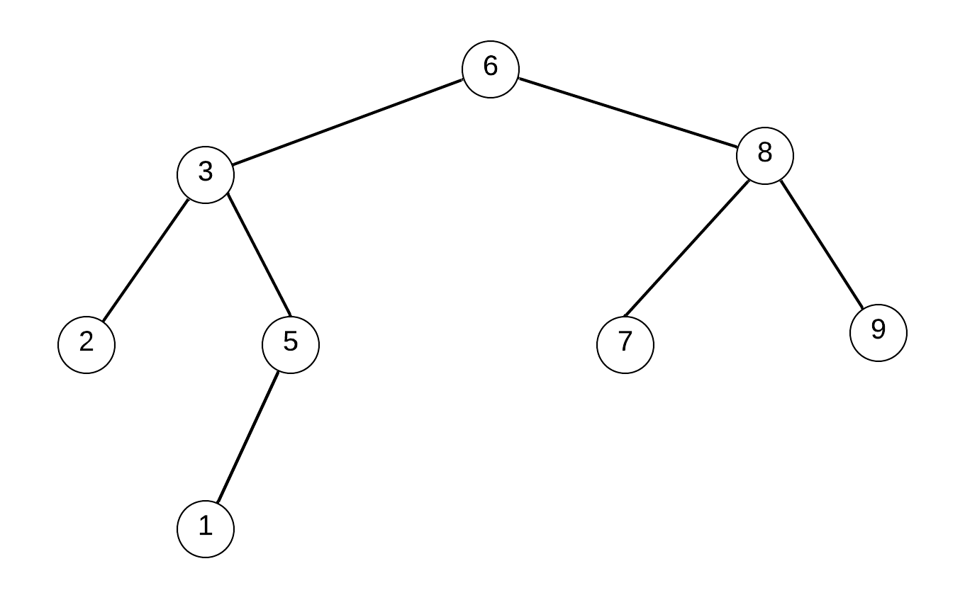
Definition of Balanced Tree
The tree is a balanced tree if:
The left and right subtrees' heights differ by at most one
The left subtree is balanced
The right subtree is balanced
Unbalanced
Balanced
Notes:
Balanced tree only make sense for BST. Non-bst traversal any way.

Slide 53
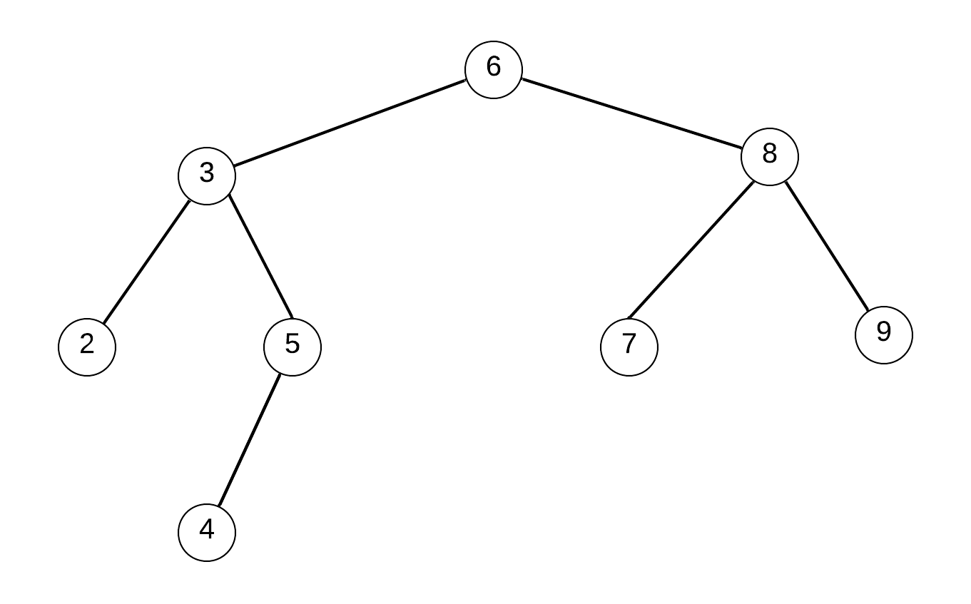
Is Balanced Tree?
Unbalanced
Balanced

Slide 54
bool isBalanced(TreeNode* root) {
if (root == nullptr)
return true;
int lBalanced = isBalanced(root->left);
int rBalanced = isBalanced(root->right);
return true;
}

Slide 55
bool isBalanced(TreeNode* root) {
if (root == nullptr)
return true;
int lBalanced = isBalanced(root->left);
int rBalanced = isBalanced(root->right);
int lHeight = getHeight(root->left);
int rHeight = getHeight(root->right);
if (lBalanced == false || rBalanced == false) return false;
if (abs(lHeight - rHeight) > 1) return false;
return true;
}

Slide 56
pair<int, bool> isBalancedT(TreeNode* root) {
if (root == nullptr)
return make_pair(0, true);
auto [lHeight, lBalanced] = isBalancedT(root->left);
auto [rHeight, rBalanced] = isBalancedT(root->right);
return make_pair(?);
}

Slide 57
pair<int, bool> isBalanced(TreeNode* root) {
if (root == nullptr)
return make_pair(0, true);
auto [lHeight, lBalanced] = isBalanced(root->left);
auto [rHeight, rBalanced] = isBalanced(root->right);
bool balanced = true;
if (lBalanced == false || rBalanced == false) balanced = false;
else if (abs(lHeight - rHeight) > 1) balanced = false;
int currentHeight = max(lHeight, rHeight) + 1;
return make_pair(currentHeight, balanced);
}

Slide 58
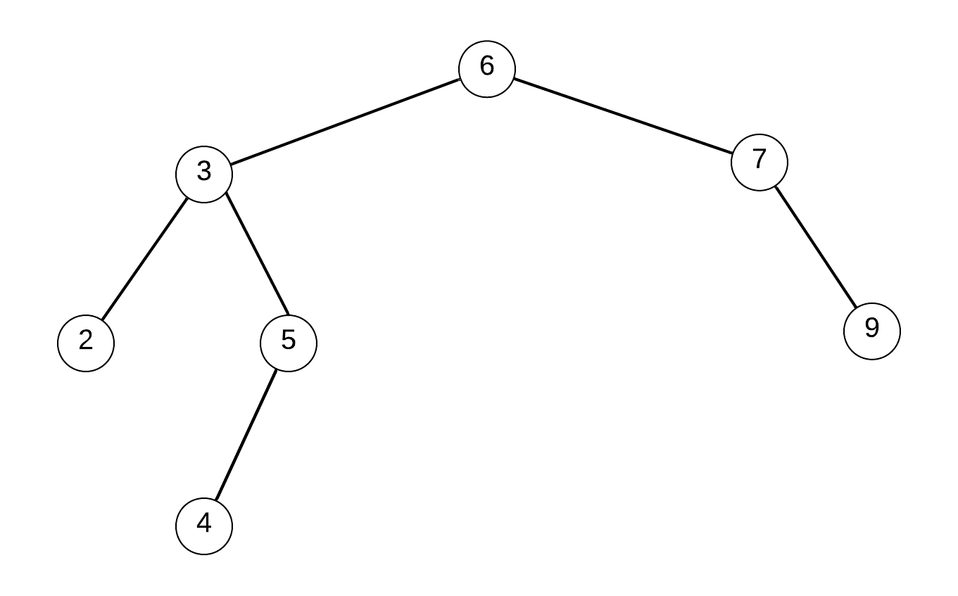
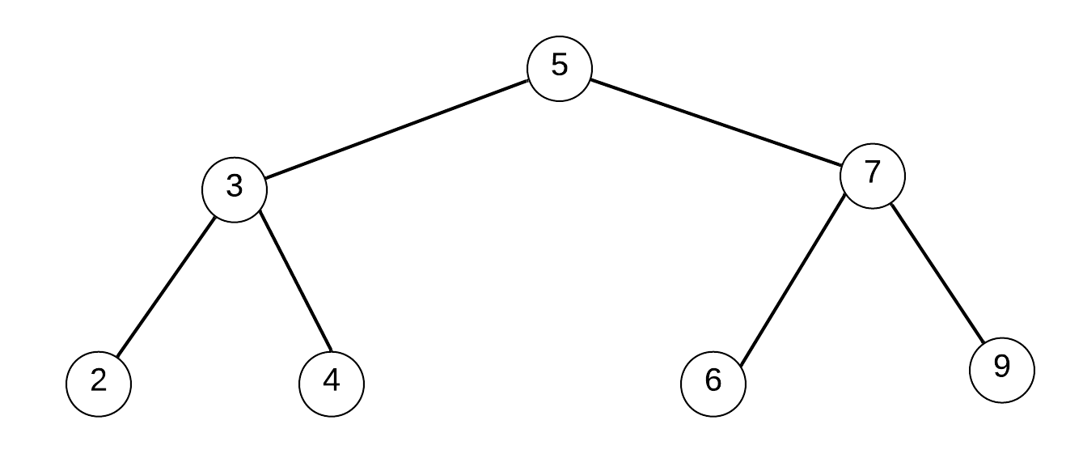
BST to Balanced BST

Slide 59
void storeBSTNodes(TreeNode* root, vector<TreeNode*> &nodes)
{
if (root == nullptr)
Return;
storeBSTNodes(root->left, nodes);
nodes.push_back(root);
storeBSTNodes(root->right, nodes);
}

Slide 60
TreeNode* buildTree(const vector<Node*> &nodes,
int start, int end) {
if (start > end)
return nullptr;
int mid = (start + end)/2;
TreeNode *root = new TreeNode(nodes[mid]);
root->left = buildTree(nodes, start, mid-1);
root->right = buildTree(nodes, mid+1, end);
return root;
}
Notes:
Structure of build is similar to traversal.

Slide 61
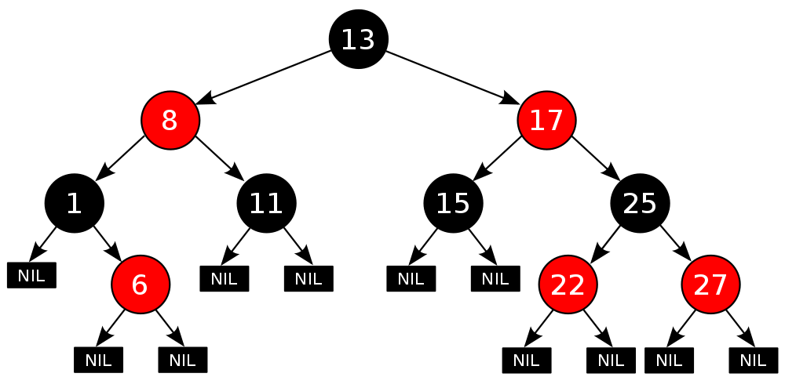
Red-black tree
BST with:
Each node is either red or black.
The root is black.
All leaves (NIL) are black.
If children of red node are black.
Every path from a root to NIL nodes contains the same number of black nodes.
Notes:
Max length = 2 * (min length) not exact balanced

Slide 62
struct RBNode
{
int val;
bool color;
Node *left, *right, *parent;
RBNode(int val_) :
val{val_}, color{RED},
left{nullptr}, right{nullptr},
parent{nullptr} {}
};
Notes:
Color used to label node.
Parent for quick rotation after insert or delete.

Slide 63
Is RB Tree?
BST with:
Each node is either red or black.
The root is black.
All leaves (NIL) are black.
If children of red node are black.
Every path from a root to NIL nodes contains the same number of black nodes.
bool isRBTree(RBNode *root) {
if (root->color != BLACK) return false;
if (redHasRChild(root)) return false;
if (!samePathCount(root)) return false;
return true;
}

Slide 64
bool redHasRChild(root) {
if (!root)
return false;
if (root->color == RED) {
if (root->left && root->left->color == RED) return true;
if (root->right && root->right->color == RED) return true;
}
if (redHasRChild(root->left)) return true;
if (redHasRChild(root->right)) return true;
return false;
}

Slide 65
bool samePathCount(RBNode *root) {
int pathCount = -1;
return samePathCount(root, 0, pathCount);
}
bool samePathCount(RBNode *root, int blackCount, int &pathCount) {
if (!root) {
if (pathCount == -1) pathCount = blackCount;
return pathCount == blackCount;
}
if (root->color == BLACK) blackCount++;
if (!samePathCount(root->left, blackCount, pathCount)) return false;
if (!samePathCount(root->right, blackCount, pathCount)) return false;
return true;
}

Slide 66
struct RBNode
{
int val;
bool color;
Node *left, *right, *parent;
RBNode(int val_) :
val{val_}, color{RED},
left{nullptr}, right{nullptr},
parent{nullptr} {}
};
void insert(RBNode *root, const int val)
{
RBNode *node = new Node(val);
root = insertNode(root, node);
fixViolation(root, node);
}

Slide 67
RBNode *insertNode(RBNode *root, RBNode *node) {
if (!root) return node;
if (node->val < root->val) {
root->left = insertNode(root->left, node);
root->left->parent = root;
}
if (node->val > root->val) {
root->right = insertNode(root->right, node);
root->right->parent = root;
}
return root;
}
struct RBNode
{
int val;
bool color;
Node *left, *right, *parent;
RBNode(int val_) :
val{val_}, color{RED},
left{nullptr}, right{nullptr},
parent{nullptr} {}
};

Slide 69
Overview
Basic knowledge of Trees
Tree Traversal
BST
Balance of Trees
Variants of Trees

Slide 70
Trie (Prefix Tree)
a t i
te to in
tea ted ten inn
a to tea ted ten in inn
Notes:
Word autocomplete could use trie

Slide 71


Slide 72
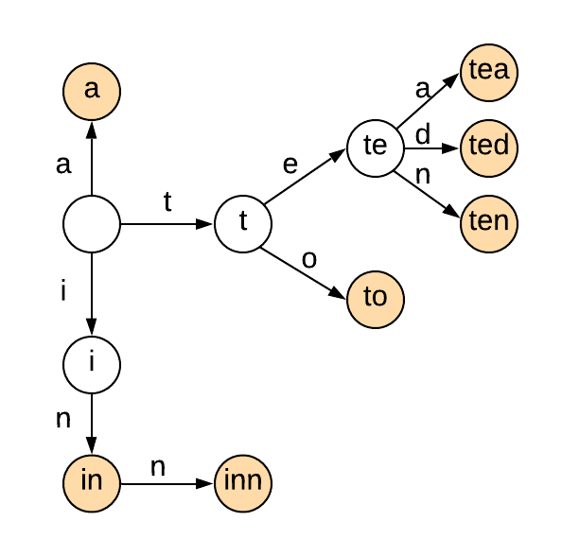
Trie (Prefix Tree)
struct TrieNode {
vector<TrieNode *> nodes;
bool isWord;
TrieNode() : isWord{false},
nodes(ASCII_SIZE, nullptr) {}
};
a t i
te to in
tea ted ten inn
a to tea ted ten in inn
Notes:
Real interview question.
Question is easy.
Implementation is a little challenge
The node is not the character, the link is.

Slide 73
Trie (Prefix Tree)
class Trie {
public:
Trie() {}
void insert(string &word) {}
bool search(string &word) {}
bool startsWith(string &prefix) {}
};
Notes:
Operation more like BST

Slide 74
class Trie {
private:
TrieNode *root;
public:
Trie() {
root = new TrieNode;
}
};
struct TrieNode {
vector<TrieNode *> nodes;
bool isWord;
TrieNode() :
isWord{false},
nodes(ASCII_SIZE, nullptr) {}
};

Slide 75
void insert(string &word) {
auto node = root;
for (char c: word) {
int cIndex = c - 'a';
if (!node->nodes[cIndex])
node->nodes[cIndex] = new TrieNode();
node = node->nodes[cIndex];
}
node->isWord = true;
}
struct TrieNode {
vector<TrieNode *> nodes;
bool isWord;
TrieNode() :
isWord{false},
nodes(ASCII_SIZE, nullptr) {}
};

Slide 76
bool search(string &word) {
auto node = root;
for (char c: word) {
int cIndex = c - 'a';
if (!node->nodes[cIndex]) return false;
node = node->nodes[cIndex];
}
return node->isWord;
}
struct TrieNode {
vector<TrieNode *> nodes;
bool isWord;
TrieNode() :
isWord{false},
nodes(ASCII_SIZE, nullptr) {}
};

Slide 77
bool startsWith(string &prefix) {
auto node = root;
for (char c: prefix) {
int cIndex = c - 'a';
if (!node->nodes[cIndex]) return false;
node = node->nodes[cIndex];
}
return true;
}
struct TrieNode {
vector<TrieNode *> nodes;
bool isWord;
TrieNode() :
isWord{false},
nodes(ASCII_SIZE, nullptr) {}
};

Slide 78
Word Search
Given a matrix of lower alphabets and a dictionary. Find all words in the dictionary that can be found in the matrix. A word can start from any position in the matrix and go left/right/up/down to the adjacent position. One character only be used once in one word. No same word in dictionary
Input：["doaf","agai","dcan"]，["dog","dad","dgdg","can","again"]
Output：["again","can","dad","dog"]
Explanation：
d o a f
a g a i
d c a n
search in Matrix，so return ["again","can","dad","dog"].

Slide 79
Trie vs HashTable
HashTable is much faster than Trie when find an exact word
Prefix queries problems, Trie is the much easier
Predictable O(k) lookup time (k is the size of the key)

Slide 80
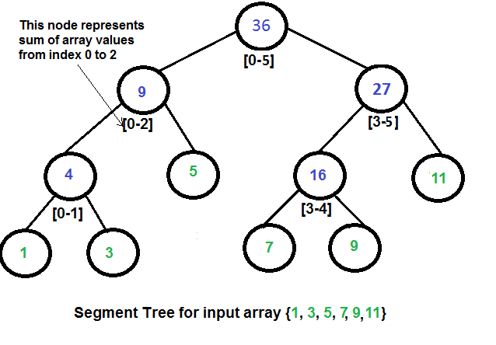
Segment Tree
Notes:
BST like

Slide 81
struct SegmentTreeNode {
long sum;
int start;
int end;
SegmentTreeNode *left;
SegmentTreeNode *right;
SegmentTreeNode(int start_, int end_):
start{start_}, end{end_},
left{nullptr}, right{nullptr}, sum{0} {}
}

Slide 82
SegmentTreeNode* buildTree(const vector<int> &nums,
int start, int end) {
auto cur = new SegmentTreeNode(start, end);
if (start == end) {
cur->sum = nums[start];
return cur;
}
int mid = (start + end)/2;
cur->left = buildTree(nums, start, mid);
cur->right = buildTree(nums, mid+1, end);
cur->sum = cur->left->sum + cur->right->sum;
return cur;
}

Slide 83
long queryTree(SegmentTreeNode* root,
int start, int end) {
if (cur->start == start && cur->end == end)
return cur->sum;
int mid = (cur->start + cur->end)/2;
if (end <= mid)
return queryTree(cur->left, start, end);
if (start > mid)
return queryTree(cur->right, start, end);
return queryTree(cur->left, start, mid) +
queryTree(cur->right, mid+1, end);
}

Slide 84
void modifyTree(SegmentTreeNode* cur, int index, int val) {
if (cur->start == cur->end) {
cur->sum = val;
return;
}
int mid = (cur->start + cur->end)/2;
if (index <= mid) modifyTree(cur->left, index, val);
else modifyTree(cur->right, index, val);
cur->sum = cur->left->sum + cur->right->sum;
}

Slide 85


Slide 86
Lowest Common Ancestor
Notes:
DFS slides

Slide 87
TreeNode * lowestCommonAncestor(TreeNode * root, TreeNode * A, TreeNode * B) {
stack<TreeNode *> sA;
stack<TreeNode *> sB;
findNode(root, A, sA);
findNode(root, B, sB);
while (sA.size() > sB.size()) sA.pop();
while (sB.size() > sA.size()) sB.pop();
while (!sA.empty()) {
auto pA = sA.top(); auto pB = sB.top();
if (pA == pB) return pA;
sA.pop(); sB.pop();
}
}

Slide 88
bool findNode(TreeNode *root, TreeNode * node, stack<TreeNode *> &s) {
if (root == nullptr) return false;
s.push(root);
if (root == node) return true;
if (findNode(root->left, node, s)) return true;
if (findNode(root->right, node, s)) return true;
s.pop();
return false;
}

Slide 89
Remove Node in BST
Notes:
Joke about first two questions are not typical BST problem. Because we don’t use the order of BST.

Slide 90
Burn the Tree

Slide 91
B-Tree
Notes:
Either in Balanced Tree Group or Variants Group here

Slide 92
Segment Tree

Slide 93
Heap

